Slide 1
Shell Bootcamp 2024 3 Reflections for Week 2
Areeb Ahmad Siddiqui
Date :6-Sep-2024

Slide 2

About Me
Quietly ambitious, constantly evolving.

Slide 3

My learnings from this week!

Slide 4
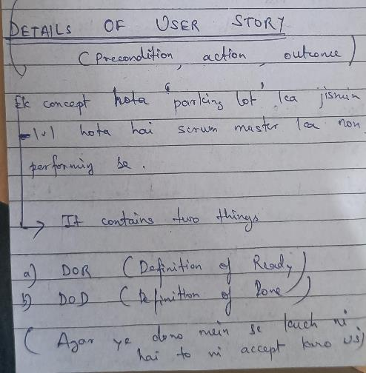
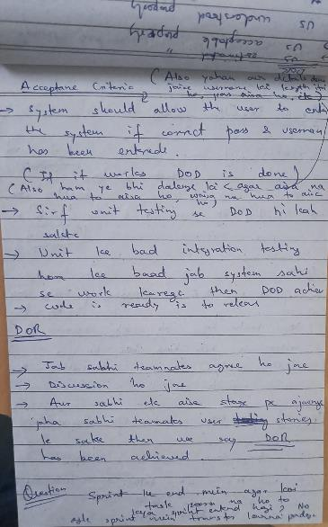
Learning 1 | My takeaways
One of the major learning of the week was User stories, which we spent a lot of time on. We had a detailed discussion on the user stories
I learned about the DOR that ensures that user stories are well-defined and ready for development, including clear business value and testable acceptance.
I also learned about the DOD that establishes the criteria for when a user story is considered complete, ensuring quality and completeness.
In an energy sector user stories with clear DOR and DOD help in managing complex smart grid projects by ensuring all requirements are met before deployment.

Slide 5
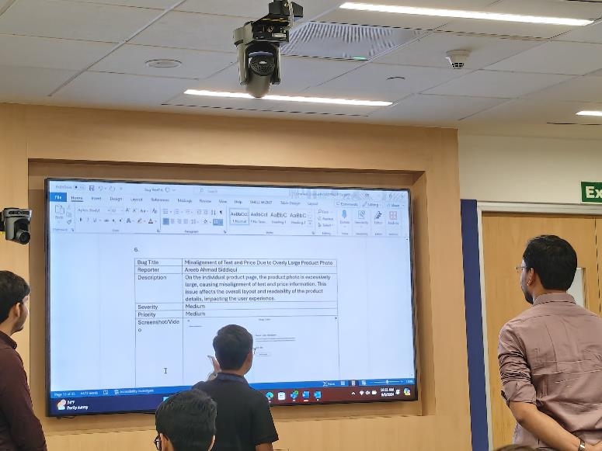
Learning 2 | My takeaways
My second learning was about the testing that are used in the industry. We had an intense discussion about all the types of testing.
I learned about functional and non-functional testing, how they are used in a real world scenario. We had a task where we need to do functional testing and find the bugs.
Also, I learned about regression testing which is a rigorous type of testing where we test the entire system end to end for any bugs. And we typically do it when a new feature has been added.
Testing in the energy sector ensures the reliability and efficiency of energy systems. The methods help verify performance, identify issues, and ensure compliance with industry standards.
In the following image after I tested the website and gave my insights on whether there are any bugs or not.

Slide 6
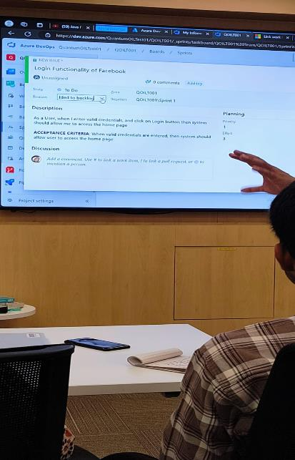
Learning 3 | My takeaways
I also learned about Azure DevOps, which is a set of development tools for continuous integration and continuous delivery (CI/CD), supporting collaboration and automation.
We did a lot of hands-on on this tool, I learned that it enhances collaboration across development teams, increases automation, and reduces manual intervention in the deployment process.
Automation through CI/CD can help in quickly deploying patches or updates to critical energy management systems, reducing downtime and ensuring stability.
The platform can also help streamline the testing and integration of IoT devices used in energy monitoring and control.
In the following image we were learning about how to setup user stories and test cases on the Azure DevOps portal

Slide 7

Relevance of learnings for my organization

Slide 8
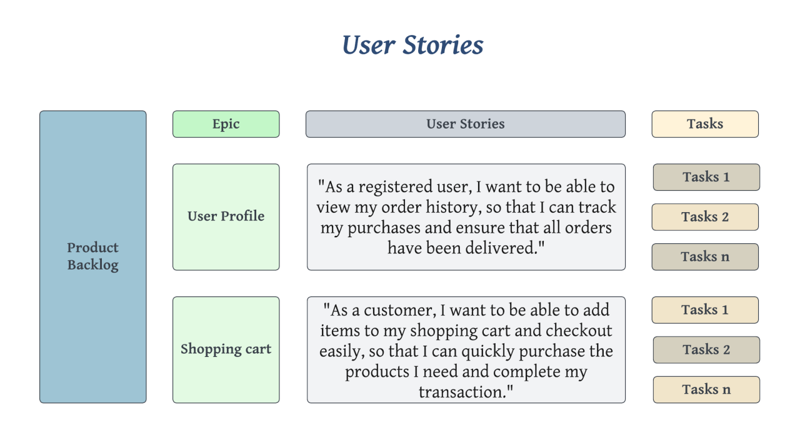
Learning 1 | Relevance for Shell
At Shell, user stories are employed in various software development projects related to energy management systems, automation, or data analytics tools. Teams use DoR and DoD to ensure that each requirement is well-defined and completed to the highest standards, ensuring seamless operation of their critical infrastructure.
By using user stories and clear acceptance criteria, Shell can ensure that all solutions meet business needs and comply with regulatory requirements. This leads to fewer delays and ensures that all solutions are tested, documented, and fully operational before deployment. It also allows for better collaboration between business and technical teams.

Slide 9
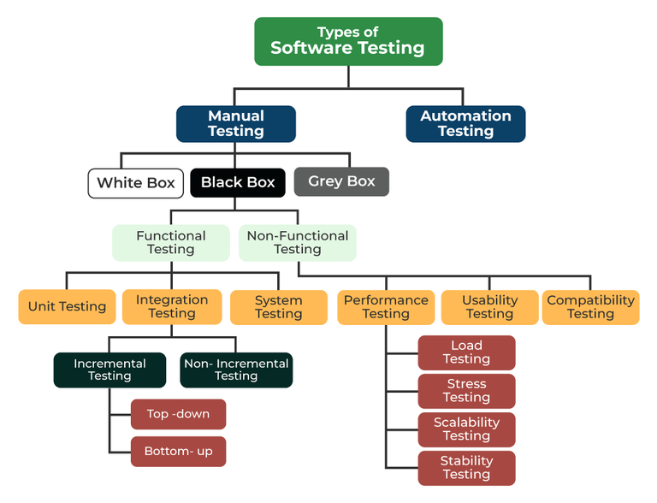
Learning 2 | Relevance for Shell
Shell applies rigorous functional and non-functional testing to ensure that its systems are not only feature-complete but also perform efficiently under stress. Given the critical nature of its operations, regression testing is essential in maintaining stability across its platforms, especially after updates or enhancements.
With well-implemented testing, Shell minimizes downtime, increases operational efficiency, and ensures that software solutions work as expected. This is particularly important in energy management systems, where operational failure could result in significant financial and safety risks. Thorough testing ensures high performance, reliability, and a good user experience for internal and external stakeholders.

Slide 10
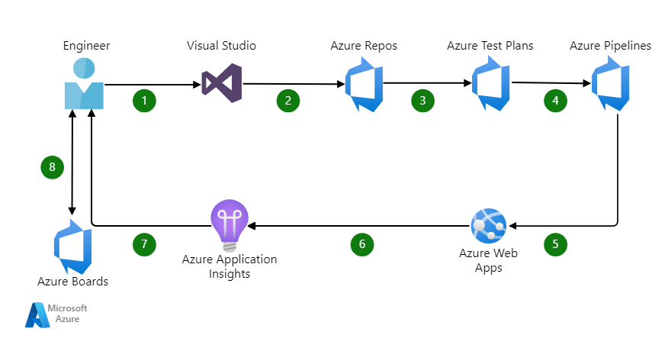
Learning 3 | Relevance for Shell
Shell uses Azure DevOps to manage large-scale projects, ensuring a streamlined workflow from code development to deployment. It helps Shell automate testing and deployment, ensuring continuous delivery and integration of new features or updates without affecting core operations.
Azure DevOps brings automation and efficiency, allowing Shell to reduce manual interventions and accelerate delivery timelines. This reduces the time-to-market for innovations in energy technologies and enables quick patches for systems critical to safety, regulatory compliance, and energy distribution.

Slide 11

Challenges in implementing learning

Slide 12
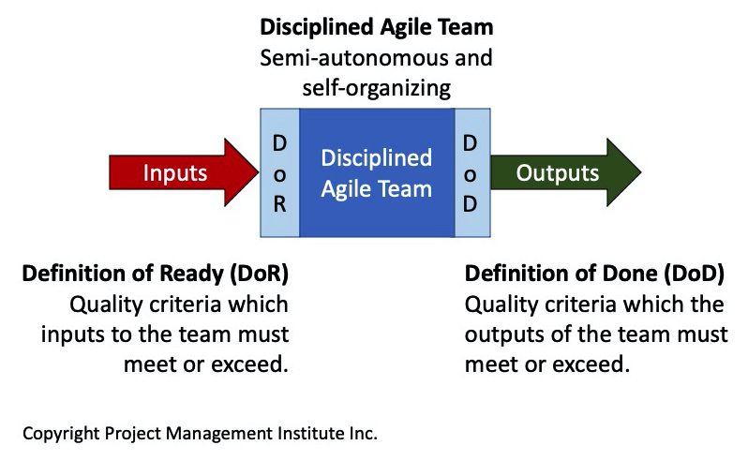
Challenge faced while implementing Learning 1
Challenges I faced:
Initially, understanding the difference between Definition of Ready (DoR) and Definition of Done (DoD) was challenging, as both require a deep understanding of project requirements.
Plan to Overcome:
To better distinguish between DoR and DoD, I plan to roleplay the work as a product owners and technical teams to understand the criteria required at each stage.
I will practice creating user stories through real-world case studies and seek feedback from senior colleagues to improve my acceptance criteria writing skills.
I plan to engage in regular retrospectives to review past user stories and identify areas of improvement.
https://github.com/AreebAhmadSiddiqui/SHELL-CASE-STUDY

Slide 13
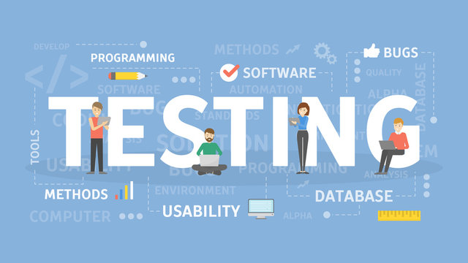
Challenge faced while implementing Learning 2
Challenges I faced:
Understanding how to prioritize testing efforts was difficult, especially when balancing functional and non-functional tests in limited timeframes. It was challenging to decide whether to focus more on ensuring core functionality or optimizing performance, usability, and security.
Plan to Overcome:
To better manage testing priorities, I plan to adopt risk-based testing approaches, where I assess the impact and likelihood of failure for each feature.
I will collaborate more closely with stakeholders to understand which non-functional requirements are most critical to the project’s success.
I also intend to improve my time management skills and explore tools that automate testing processes, allowing me to cover more ground efficiently within limited timeframes.
https://github.com/AreebAhmadSiddiqui/SHELL-CASE-STUDY

Slide 14
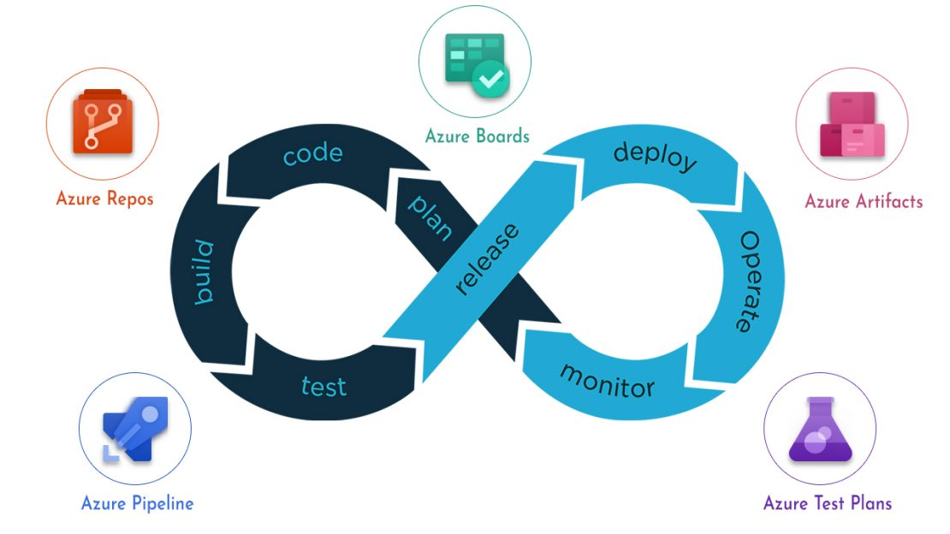
Challenge faced while implementing Learning 3
Challenges I faced:
Initially, it was challenging to understand the entire Azure DevOps ecosystem, especially the CI/CD pipeline setup and how it integrates with other tools for continuous testing and deployment.
Navigating the different features, such as product backlogs, sprints, and build pipelines, and understanding how to efficiently utilize them required time and practice.
Plan to Overcome:
I plan to take structured online courses and certifications in Azure DevOps, focusing specifically on CI/CD pipelines and how they apply to large organizations.
I will also work on small-scale personal projects using Azure DevOps to build hands-on experience and become more confident with the platform.
Seeking mentorship from colleagues already using Azure DevOps effectively will provide practical insights into overcoming daily challenges in real-world scenarios.
https://github.com/AreebAhmadSiddiqui/SHELL-CASE-STUDY

Slide 15

Action Plan

Slide 16
My Action Plan for this Week
Actions
Timeline
Status
Enroll in training sessions, workshops, and pursue certifications (e.g., Azure DevOps, testing tools) to build a strong foundation in areas like user stories, testing, and DevOps. Regularly engage in hands-on practice with personal projects to reinforce these learnings.
Use standardized templates for writing user stories that include DoR, DoD, and acceptance criteria to ensure clarity and alignment across teams. Integrate testing tools (e.g., Selenium, JMeter) and Azure DevOps to automate and streamline workflows for both development and testing.
Use Azure Dashboards and reporting tools to track progress, pipeline performance, and test results. Continuously monitor and assess both the development and testing processes, implementing improvements to enhance efficiency, reduce manual effort, and ensure high-quality outputs.
Implement a risk-based testing strategy that prioritizes high-risk areas of the system, ensuring both functional and non-functional requirements are thoroughly tested. Integrate regression testing into the CI/CD pipeline to catch potential defects early and maintain system stability.
By September end
End of week 2
End of week 2
By October end

Slide 17

Learning is also Fun!

Slide 18
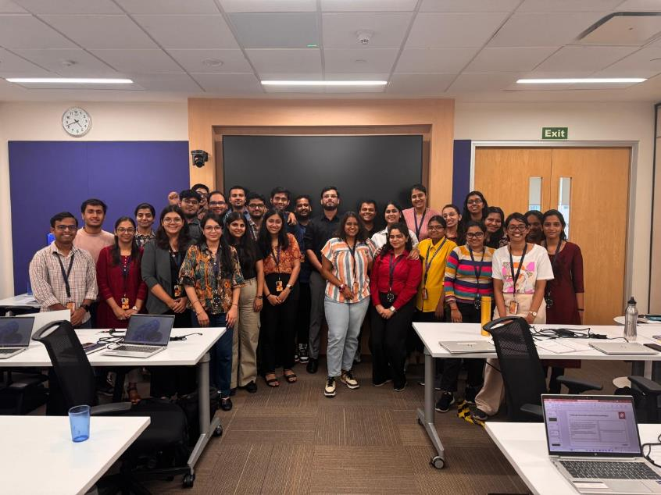
Learning is also Fun!
Today was our final evaluation casework, which tied together all the learnings from the past six days. The tasks we had to complete were quite comprehensive. We began by creating detailed user stories, which involved capturing requirements and defining clear acceptance criteria. From there, we moved on to writing and evaluating test cases, which required us to think critically about both functional and non-functional aspects of the system. Identifying bugs was particularly challenging, as we had to dive deep into the scenarios we had created.
In addition, we were tasked with setting up a virtual machine and implementing a CI/CD pipeline, which gave me a real-world understanding of how continuous integration and deployment work in practice. It was a fast-paced and intense day, with so many moving parts, but at the same time, it was incredibly rewarding. The hands-on nature of the exercise allowed me to apply theoretical knowledge in a practical context, and I felt like I learned so much more through direct experience. Despite the challenges, I really enjoyed the process and came out of it with a much clearer grasp of the concepts.

Slide 19

Summary
I learned the importance of clearly defining the Definition of Done (DoD) and Definition of Ready (DoR) for user stories to ensure development aligns with both readiness and completion criteria, leading to more predictable and successful outcomes.
I learned that functional testing validates whether the software meets user requirements, while non-functional testing ensures the software performs well under various conditions, including usability and security
I learned the significance of regression testing in verifying that new changes do not disrupt existing functionalities, thus maintaining the stability and reliability of the software over time.
I learned how Azure DevOps facilitates seamless integration and continuous deployment through its suite of tools, which improves project management, code versioning, and collaboration throughout the development lifecycle.
I learned that integrating user stories, testing methodologies, and Azure DevOps in a practical activity demonstrates how combining these elements creates a cohesive and efficient development process, highlighting their interconnectedness.
Upcoming Topics:
I plan to learn how to build intuitive and responsive user interfaces in frontend development to enhance my ability to create engaging web experiences.
I plan to learn backend development with .NET and C# to develop robust and scalable applications, effectively managing both business logic and data handling.
I learned that integrating user stories, testing methodologies, and Azure DevOps into a cohesive development process is foundational for effective software development, and I look forward to applying these principles to frontend development and backend programming with .NET/C# to further enhance my technical skills and create well-rounded applications.

Slide 20
Thank You

